Slide 1


مهندسی اینترنت
محمدرضا باباولیان
جلسه 2

Slide 2

What is Internet
The Internet (or internet) is the global system of interconnected computer networks that uses the Internet protocol suite (TCP/IP) to communicate between networks and devices. It is a network of networks that consists of private, public, academic, business, and government networks of local to global scope, linked by a broad array of electronic, wireless, and optical networking technologies
Advanced Research Projects Agency Network (ARPANET)
Internet Engineering

Slide 3
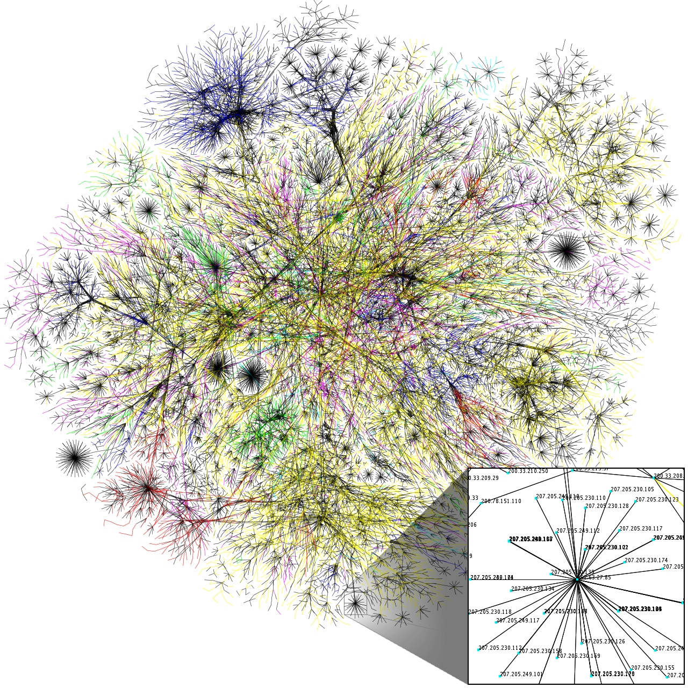
Internet Engineering

Slide 4
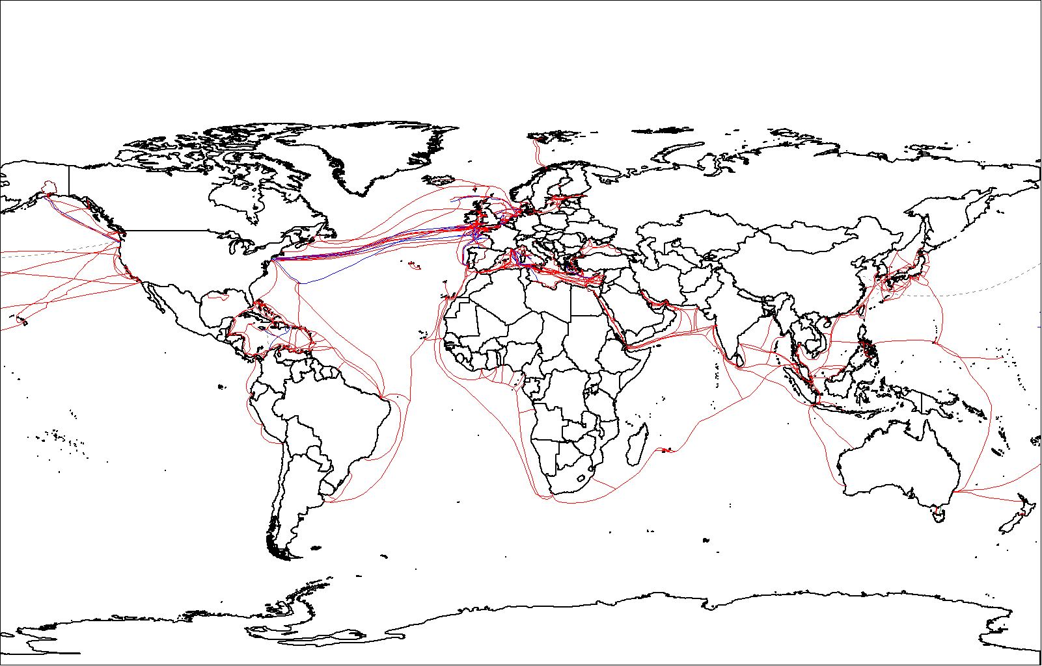
World map of submarine cables
Internet Engineering

Slide 5
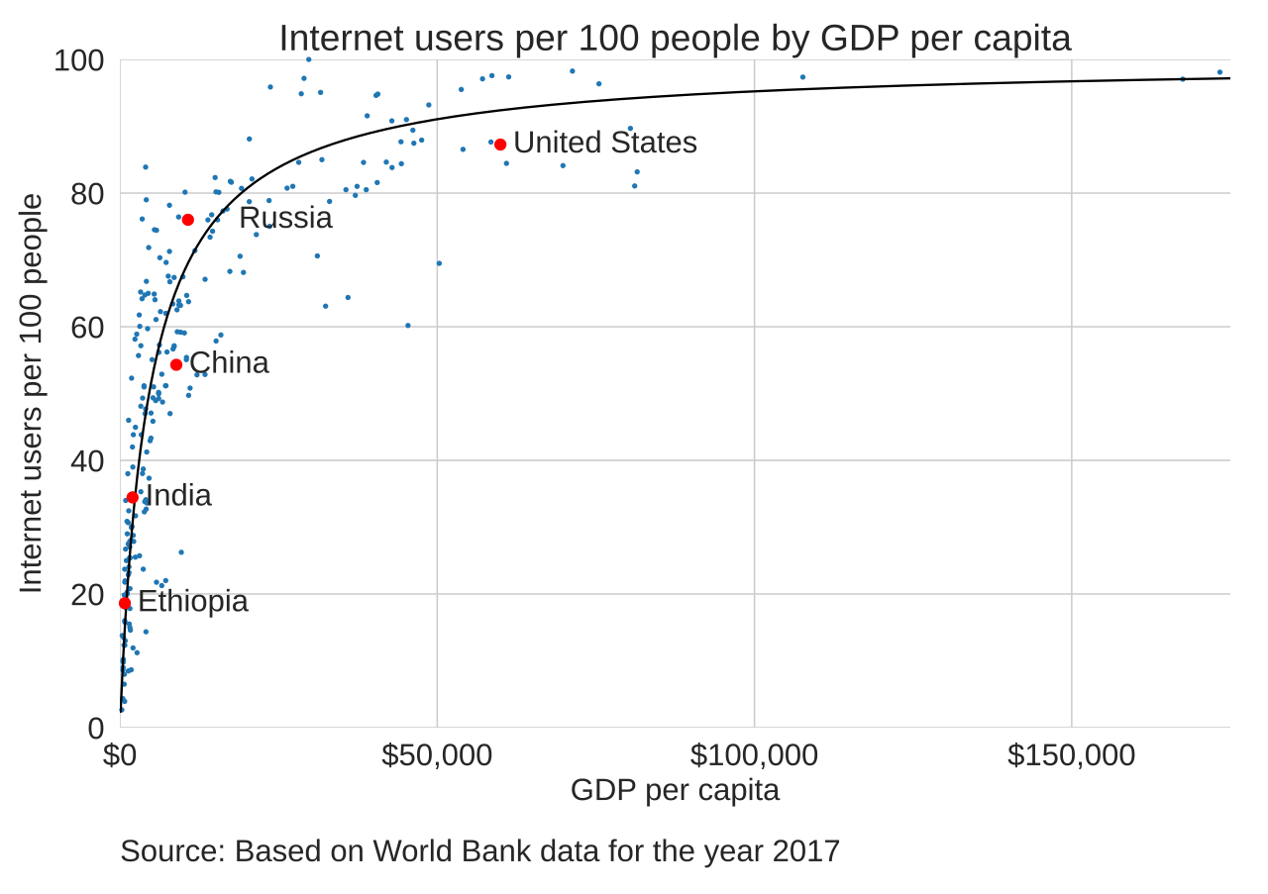
Internet Engineering

Slide 6
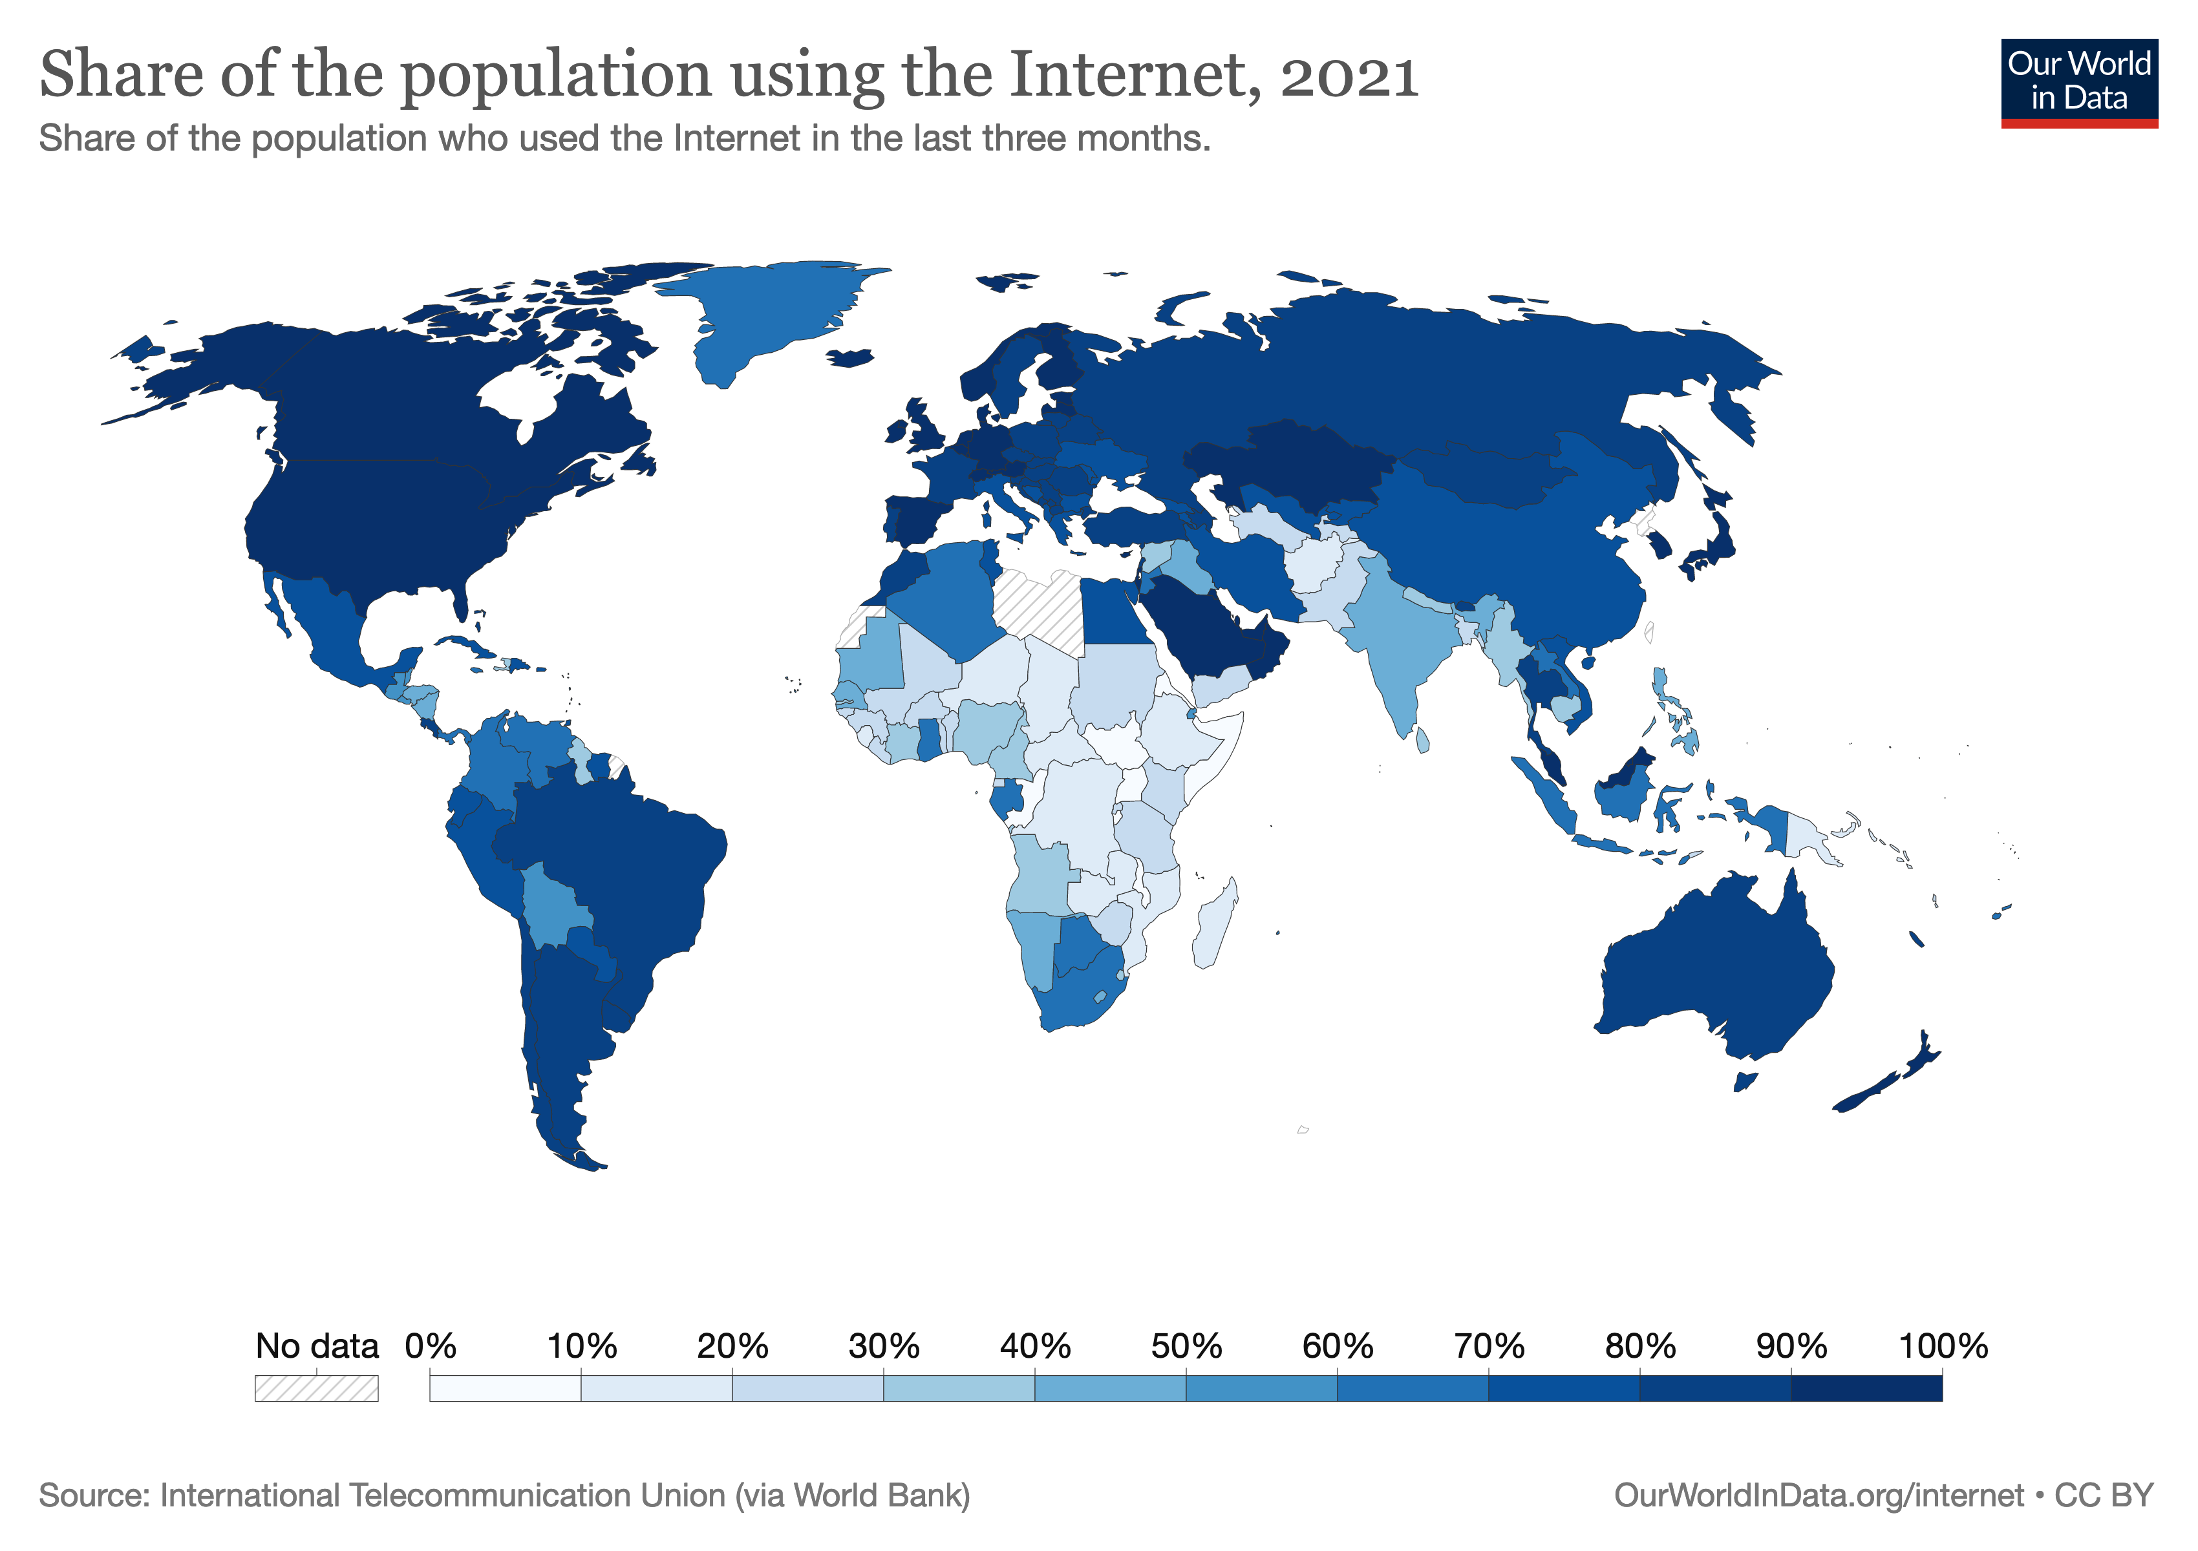
Internet Engineering

Slide 7

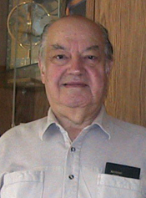
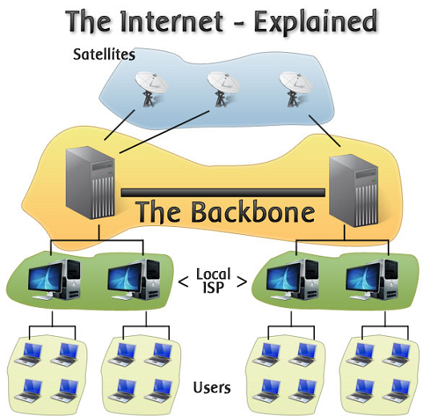
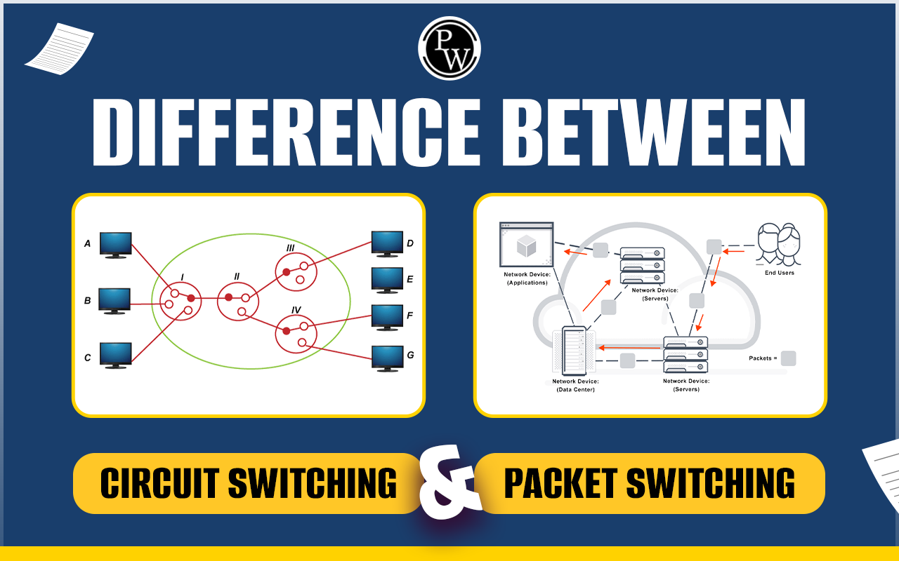
Paul Baran
Latency
Packet Loss
Scalability
Economic
Internet Engineering

Slide 8
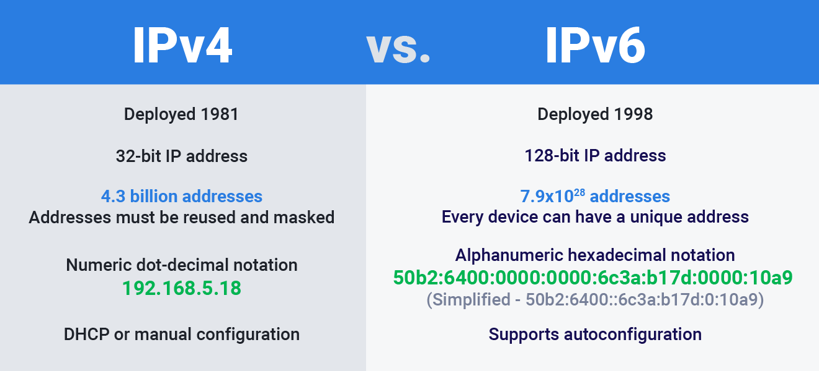
Addressing Mechanism
Network Address Translation (NAT)
Internet Engineering

Slide 9
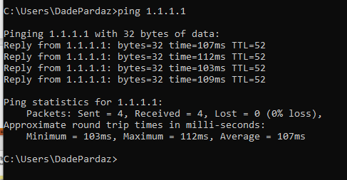
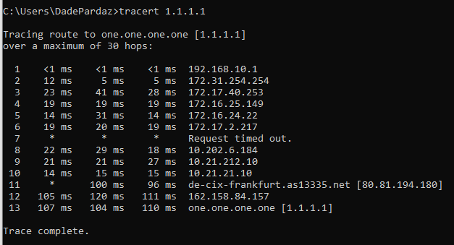
Internet Engineering

Slide 10
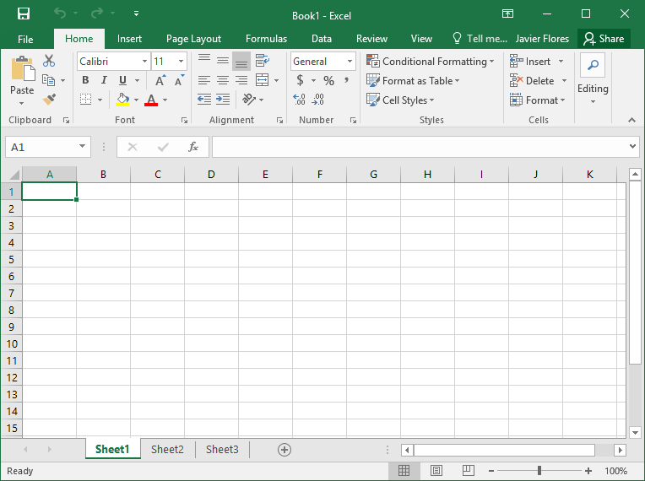
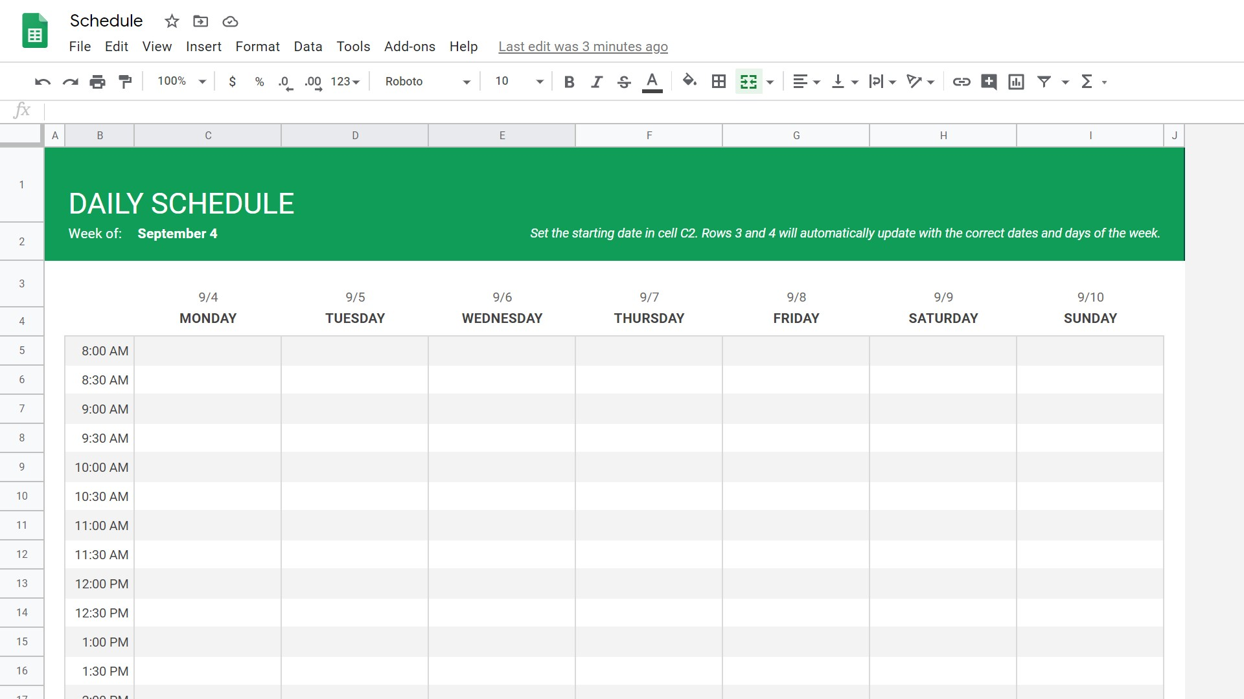
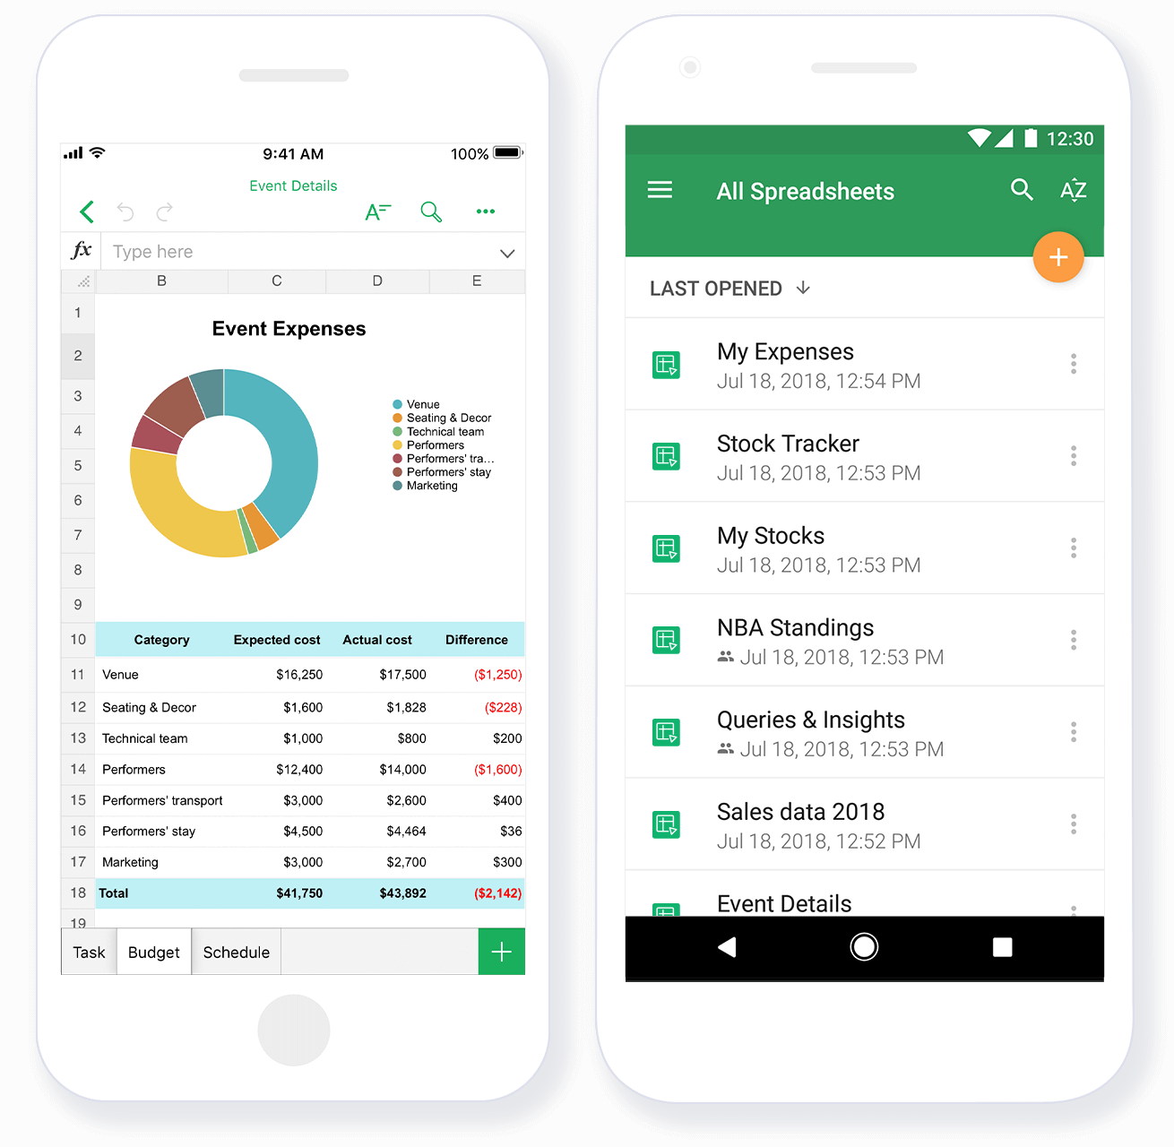
Microsoft Excel
Application
Google spreadsheet
Web Application
What's the difference between Excel and Google spreadsheet?
From end user view?
From Developer/Development view?
Google spreadsheet
Mobile Application
Internet Engineering

Slide 11
How does application development differ for internet ap-plications?
Security?
Framework?
Architecture?
Asynchronous (ping time VS. speed time) ?
Use cases (save does nor appear in google spreadsheet)
Multi user?
Internet Engineering

Slide 12
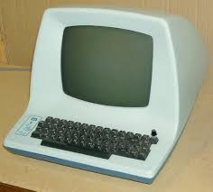
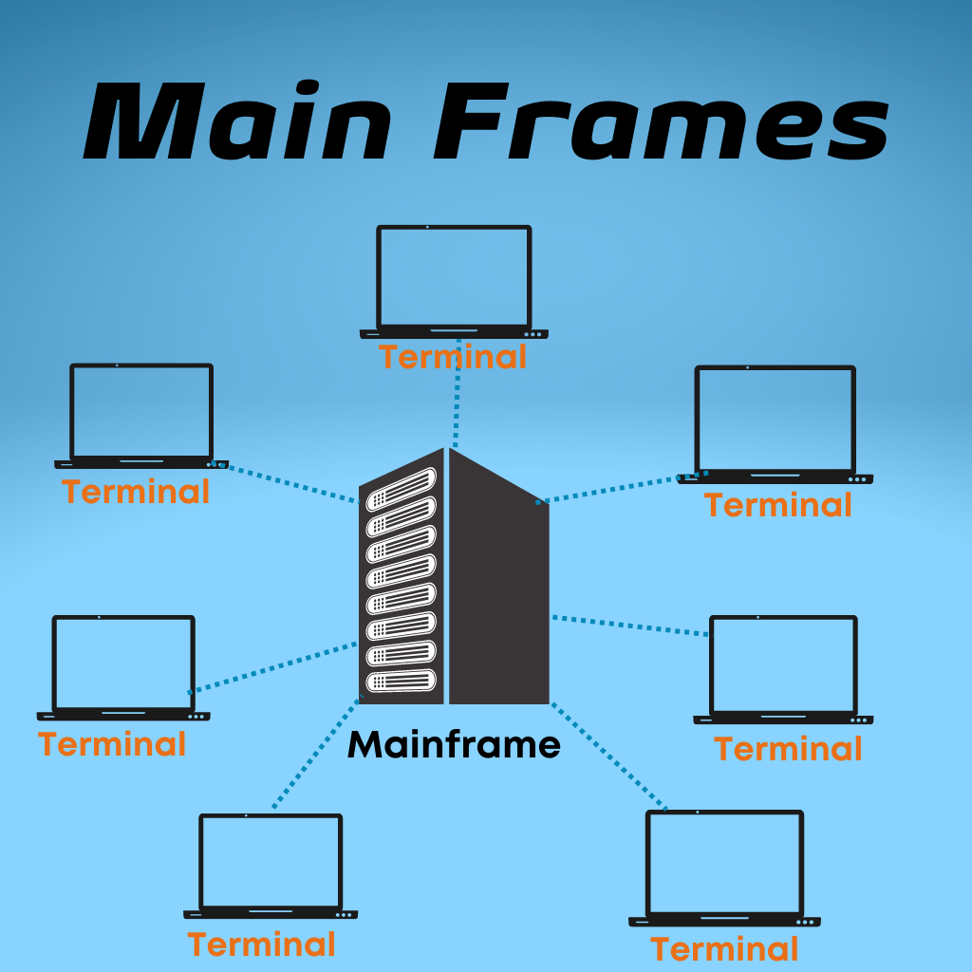
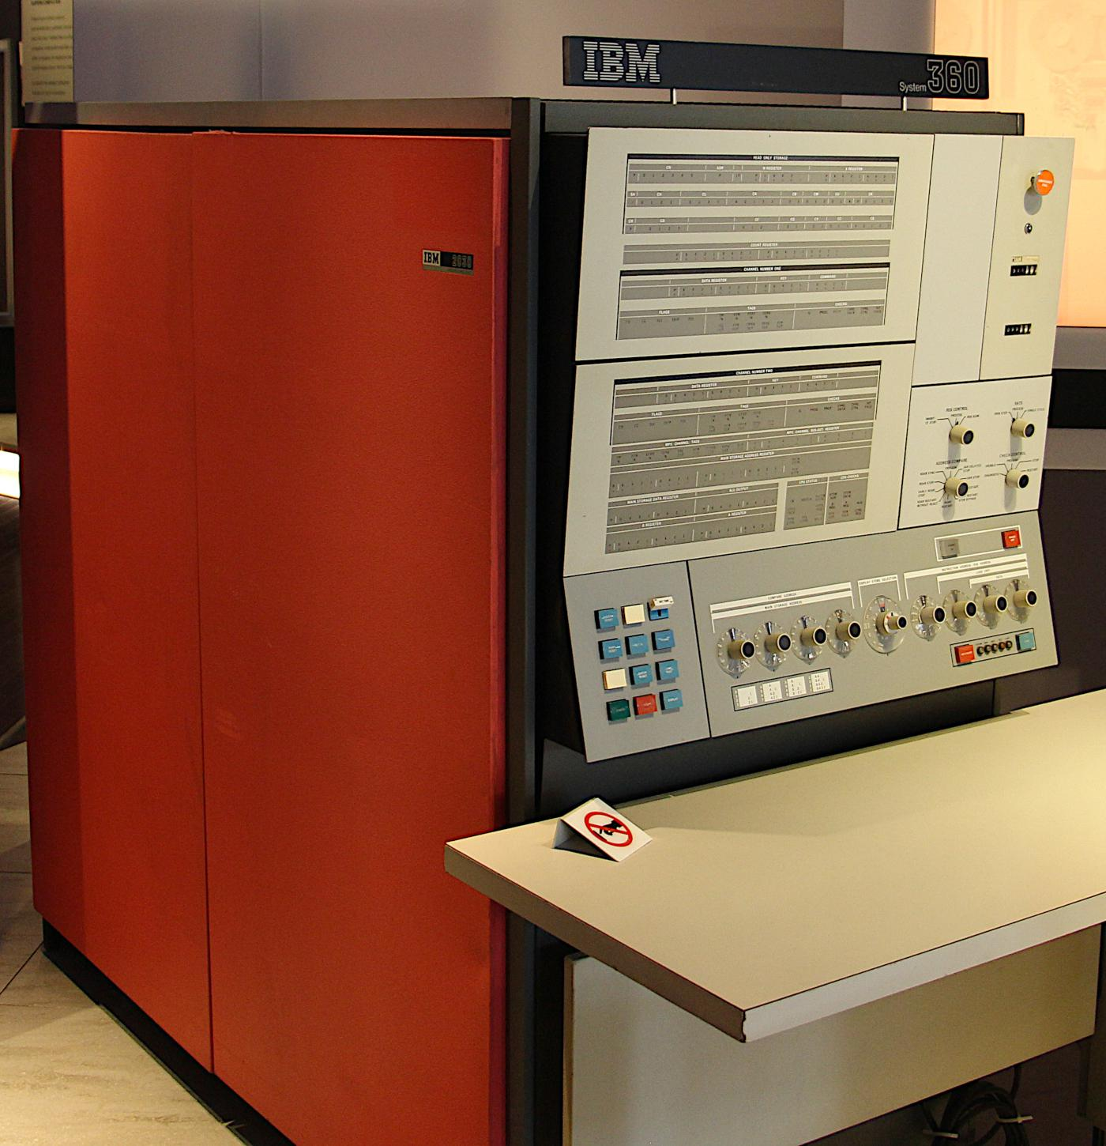

Terminal
History
IBM 360: Mainframe
Internet Engineering

Slide 13
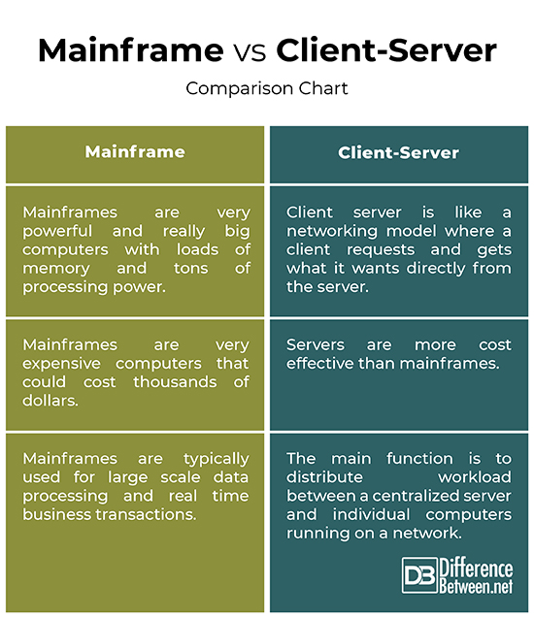
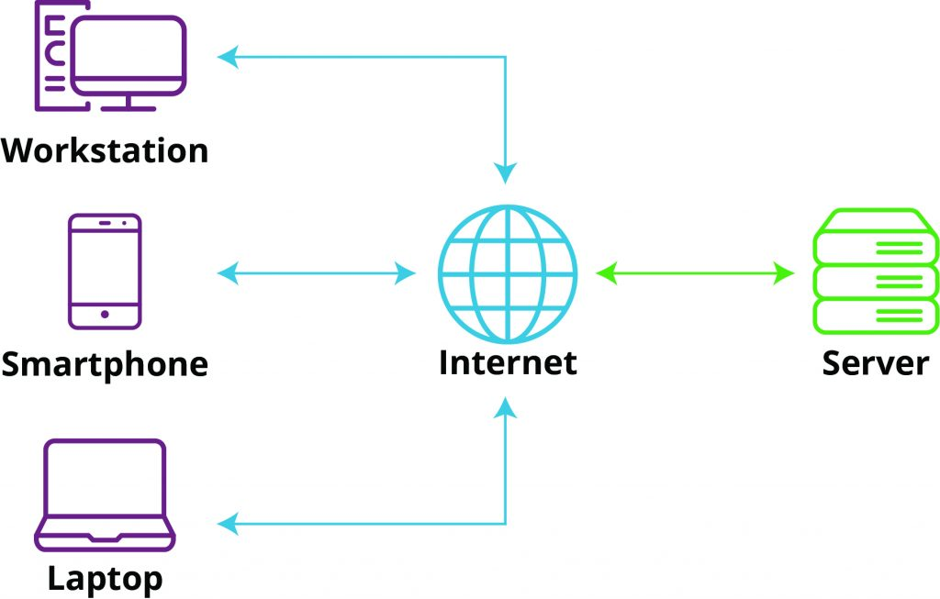
Internet Engineering

Slide 14
در نسخه سنتی معماری Client-Server داده ها در سرور ذخیره شد و پردازش در کلاینت انجام شد
Static Web Contents
در طول زمان، پردازش هم به سرور منتقل شد ولی به صورت توزیع شده.
Web Applets
Web Applications
Rich Web Applications
Web Services
Internet Engineering

Slide 15
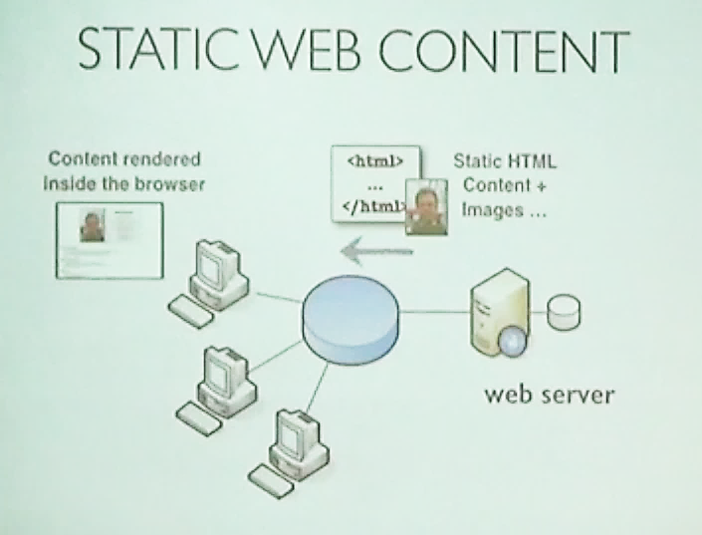
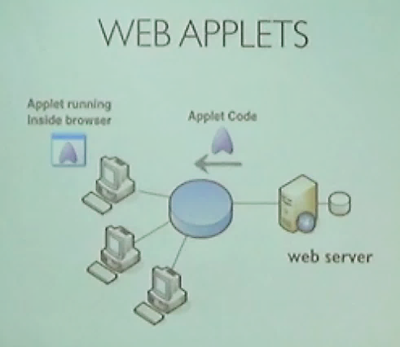
Internet Engineering

Slide 16

Browser WAR
Internet Engineering

Slide 17
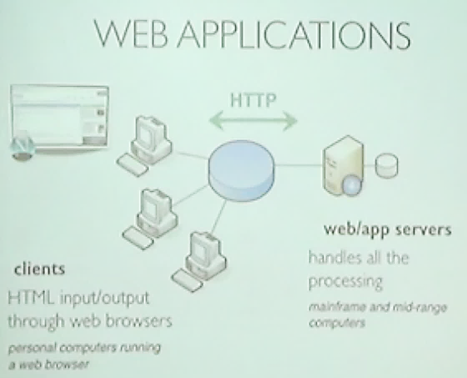

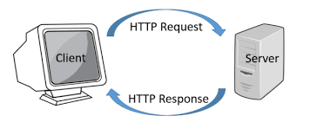
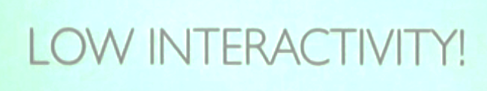
Internet Engineering

Slide 18
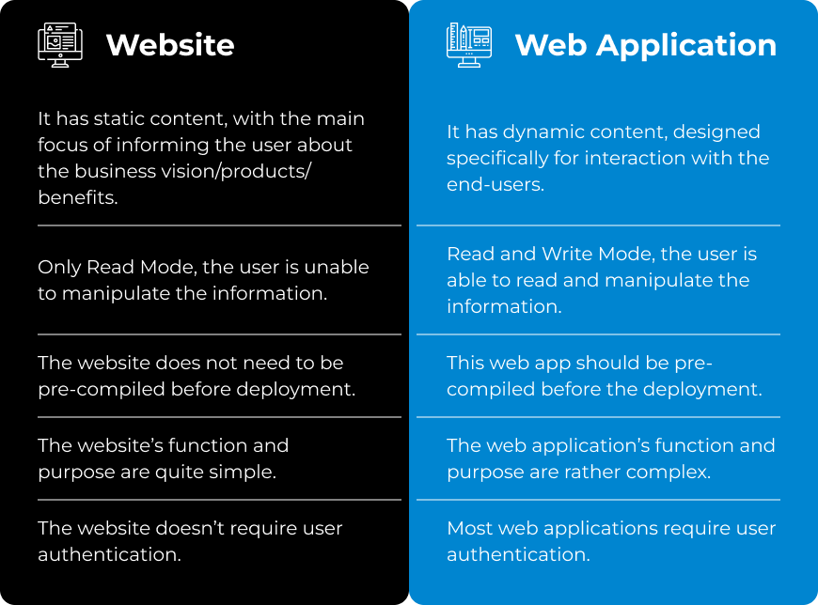
Internet Engineering

Slide 19
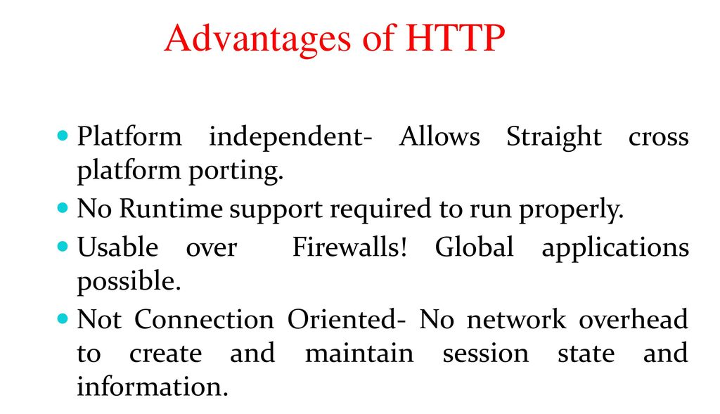
Internet Engineering

Slide 20
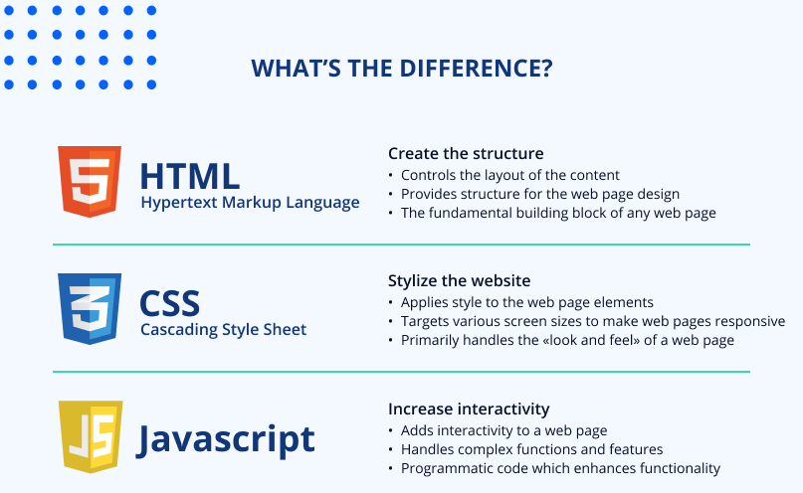

Internet Engineering

Slide 21
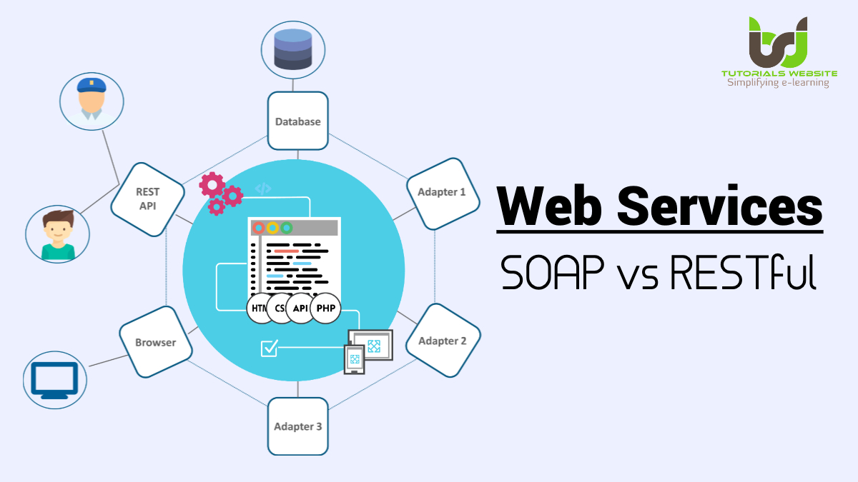
Internet Engineering

Slide 22
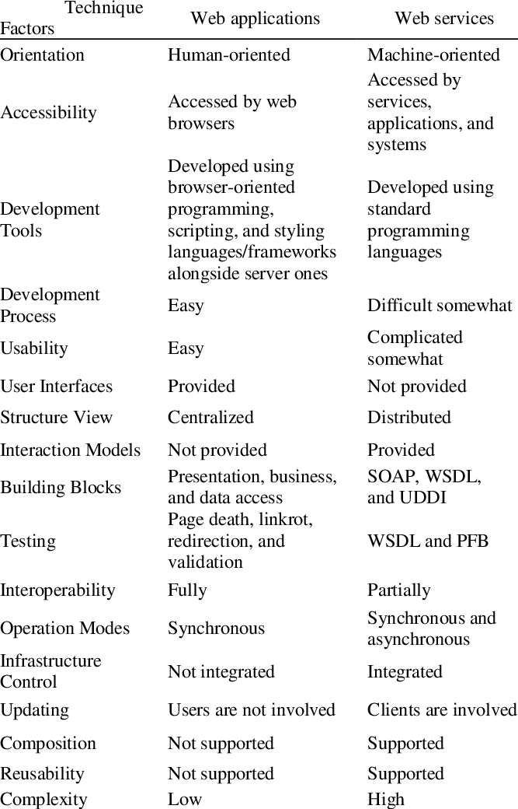
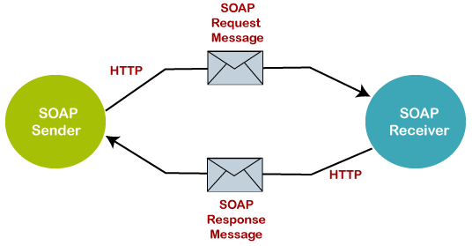
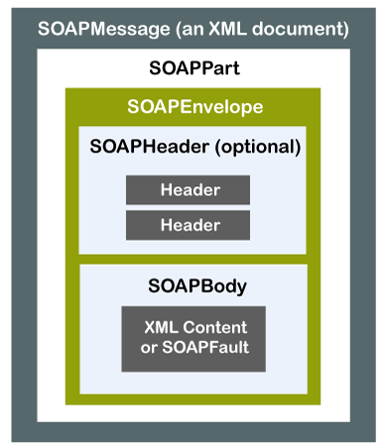
Internet Engineering

Slide 23
WEB Challenges? From User View
RAM
HARD
CPU
Net Speed
Internet Engineering

Slide 24



WEB Challenges? From Company View
iPhoto
iDataCenter
Security
Virtualization
Capacity
Power
Internet Engineering

Slide 25
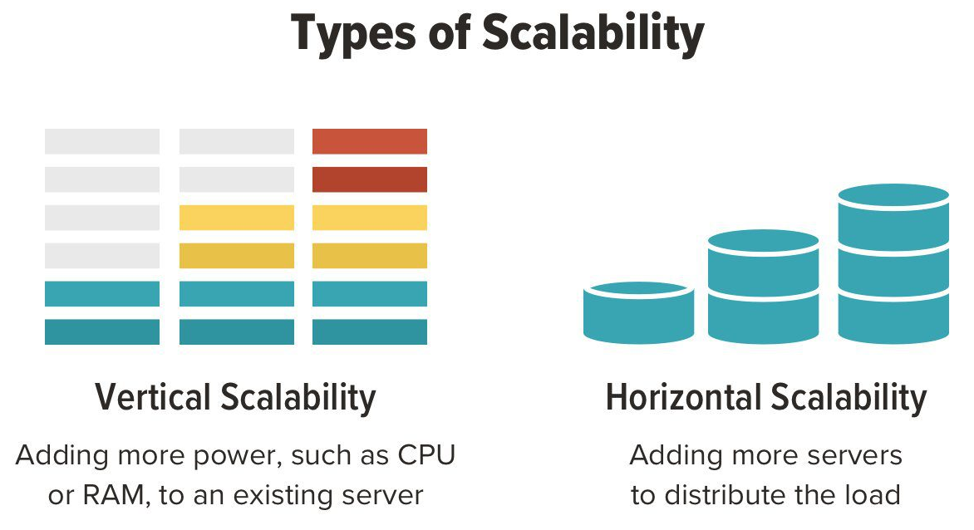

SCALABILITY
Internet Engineering

Slide 26
Metrics
Scalability
Availability
Security
Performance
Modifiability
Inter-Operability
Internet Engineering

Slide 27
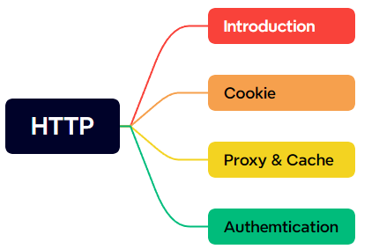

HTTP is the transfer protocol for web applications
HTTP : Hyper Text Transfer Protocol
HTTP 1.0 (RFC 1945), HTTP 1.1 (RFC 2068), HTTP 2 (RFC 7540)
In fact, it can be used to transfer everything (not only hyper text)
Text Documents e.g. HTML, XML, JSON, etc.
Multimedia e.g. JGP, GIF, MP4, MKV, etc.
Application e.g. PDF, ZIP, etc.
Internet Engineering

Slide 28

Introduction
HTTP uses the client/server paradigm
HTTP server provides resource
HTTP client (usually web browser) gets resource
But not pure client/server communication
Proxies
Caches
...
HTTP is an application layer protocol
HTTP assumes reliable communication
over TCP
default (server) port: 80
client port is chosen randomly per connection
HTTP is Stateless
Server does not keep history/state of client
High performance & Low Complexity
Problematic in some applications (sessions)
Cookies
JSON Web Tokens
Internet Engineering

Slide 29
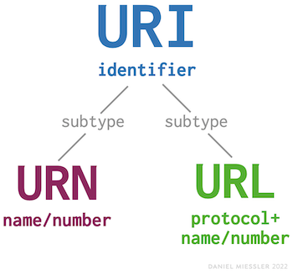
Data Resources to Transfer
HTTP is the protocol to transfer data between server and client (usually from server to client)
Which data?
It can be anything
In web, usually, it is a resource/object on server
Each resource must be identified/located uniquely
URI (Uniform Resource Identifier)
URL (Uniform Resource Locator)
URIs identify and URLs locate; however, locators are also identifiers, so
every URL is also a URI, but there are URIs which are not URLs.
A Uniform Resource Name (URN) is a URI that identifies a resource by name in a particular namespace.
International Standard Book Number (ISBN) system
Internet Engineering

Slide 30
URL
https://kashanu.ac.ir/SitePages/Home.aspx
https://www.bing.com/search?q=Hello+World&form=QBLH&sp=-1&pq=&sc=0-0&qs=n&sk=&cvid=7F2B496642F94D5F95989756B4FF60EE
file:///home/parham/Documents/Git/parham/dotfiles
http://libgen.is
ftp://speedtest.tele2.net
Scheme: The application layer protocol
HTTP: The web protocol
HTTPS: Secure HTTP
FTP: File Transfer Protocol
File: Access to a local file
javascript: Run javascript code
mailto: Send mail to given address
etc.
Path: The path of the object on host filesystem
E.g. web server root directory is /var/www/
http://www.example.com/1.html → /var/www/1.html
http://www.example.com/1/2/3.jpg → /var/www/1/2/3.jpg
http://www.example.com/1/2/../3.jpg → /var/www/1/3.jpg 🤨
Internet Engineering

Slide 31
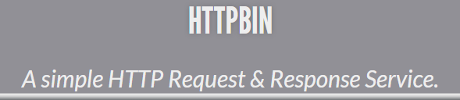
URL
Query: A mechanism to pass information from client to active pages or forms
Fill information in a university registration form
Ask Bing! to search a phrase
Starts with "?"
name=value format
"&" is the border between multiple parameters
https://httpbin.org/get?name=Parham&family=Alvani
Frag: A name for a part of resource
A section in a document
Handled by browser
Browser gets whole resource (doc) from server
In display time, it jumps to the specific part
Try these out, by:
https://github.com/gopasspw/gopass/?tab=readme-ov-file#overview
https://en.wikipedia.org/wiki/RGBA_color_model#:~:text=While%20it%20is-,sometimes,-described%20as%20a
Internet Engineering

Slide 32
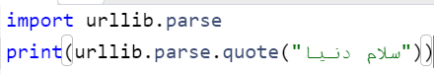
URL
Domain names are case insensitive according to RFC 4343.
The rest of URL is sent to the server via the GET method and etc. This may be case sensitive or not.
URL is encoded by client before transmission
How: Each byte is divided into two 4-bit group, hexadecimal of the 4-bits are prefixed by %
~ → 126 → %7E
What & Why?
Non-ASCII (e.g., Persian Characters, Emoji)
Reserved character when are not used for special role
Unsafe character, e.g. space, ...
Internet Engineering

Slide 33

Python: Encode URL
User asks the browser to retrieve a resource
Browser finds the ip address of <host> (DNS lookup)
Browser creates a TCP connection to the IP address and the <port>
Browser sends http requests through the connection
Browser gets the response and processes it
Site: https://dnschecker.org
Power Shell: Resolve-DnsName kashanu.ac.ir
CMD: nslookup kashanu.ac.ir
Site: https://dns.google
Internet Engineering

Slide 34
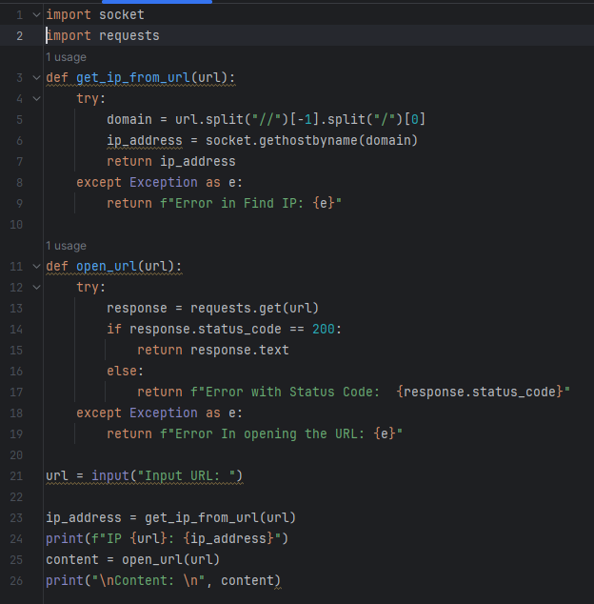

Internet Engineering

Slide 35
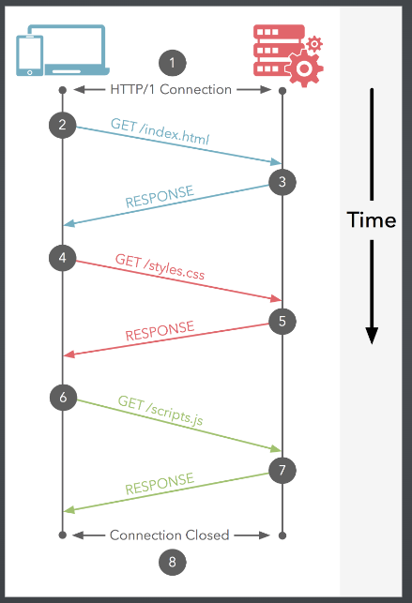
How does HTTP work? Transactions
HTTP data transfer is a collection of transactions
Each transaction is composed of Two HTTP messages
Requests are identified by methods
Method: The action that client asks from server
Responses are identified by status codes
Status: The result of the requested action
Inspect Element Network
Internet Engineering

Slide 36
HTTP Transactions in Web
(Typically) each web page contains multiple resources
The main skeleton HTML page
Some linked materials: figures, videos, JS, CSS, etc.
Displaying a web page by a browser
Get the HTML page (first transaction)
Try to display the page (rendering)
Other resources are linked to the page
Get the resources (subsequent transactions)
HTTP Transactions & TCP Connections
Non-persistent
A new TCP connection per object
Network overhead + Connection establish delay + Resource intensive
Parallel connections speed up browsing
Persistent
Get multiple objects using a single TCP connection
No extra processing & networking overhead
Poor performance if implemented in serial manner
Pipeline requests speed up browsing (HTTP/1.1)
Internet Engineering

Slide 37
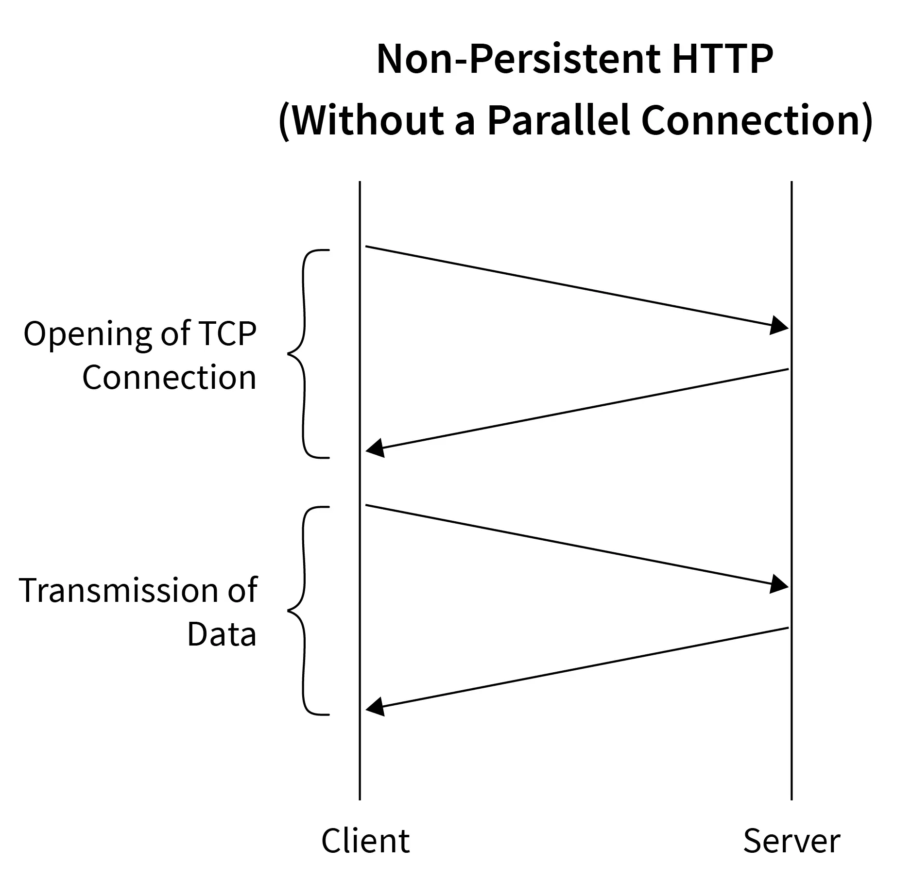
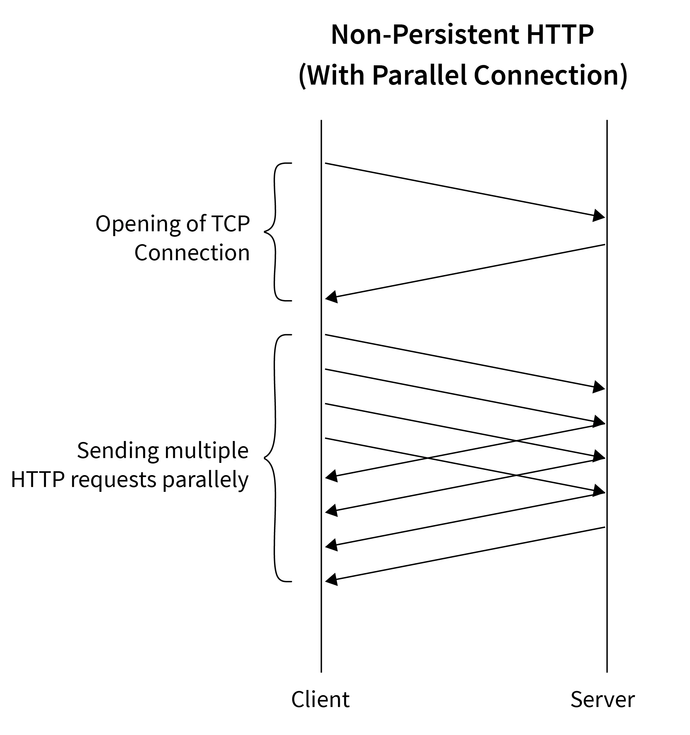
Internet Engineering

Slide 38
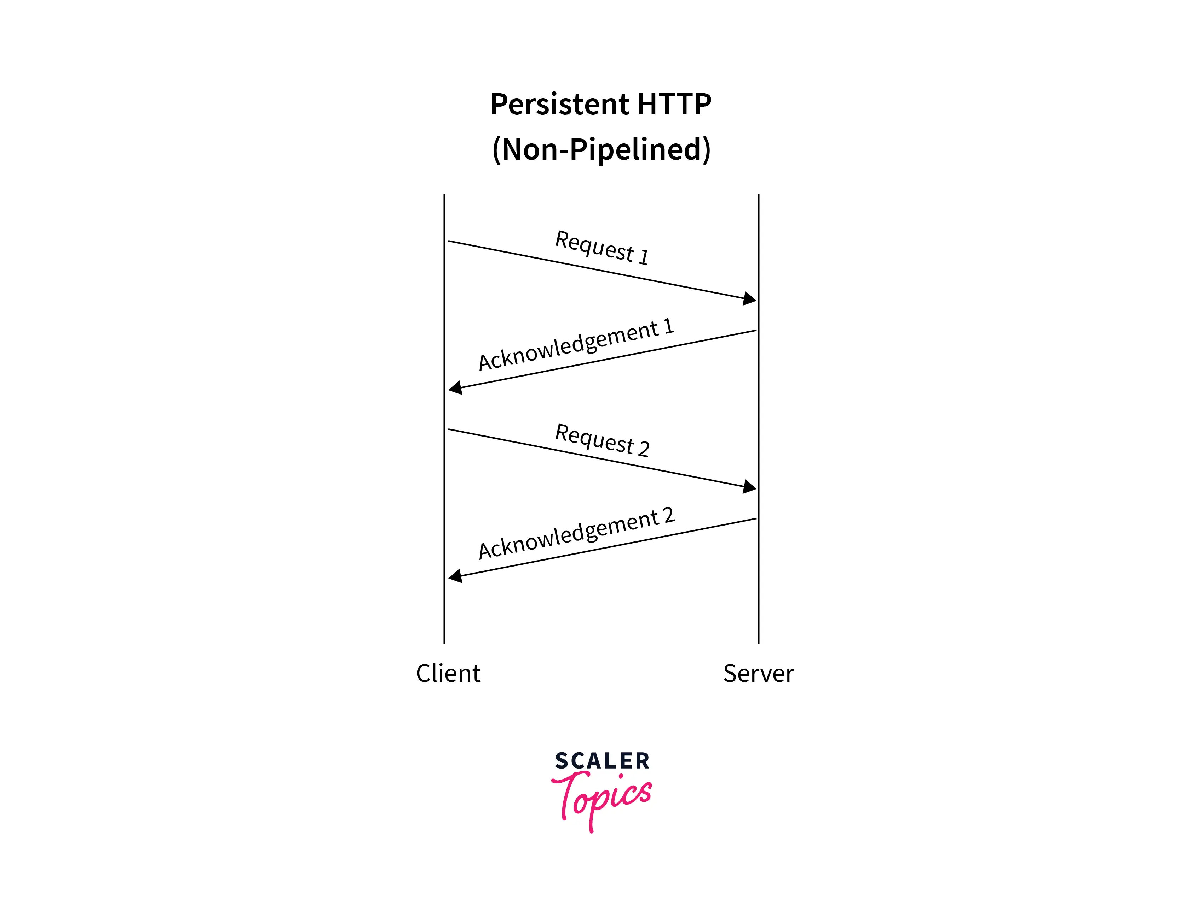
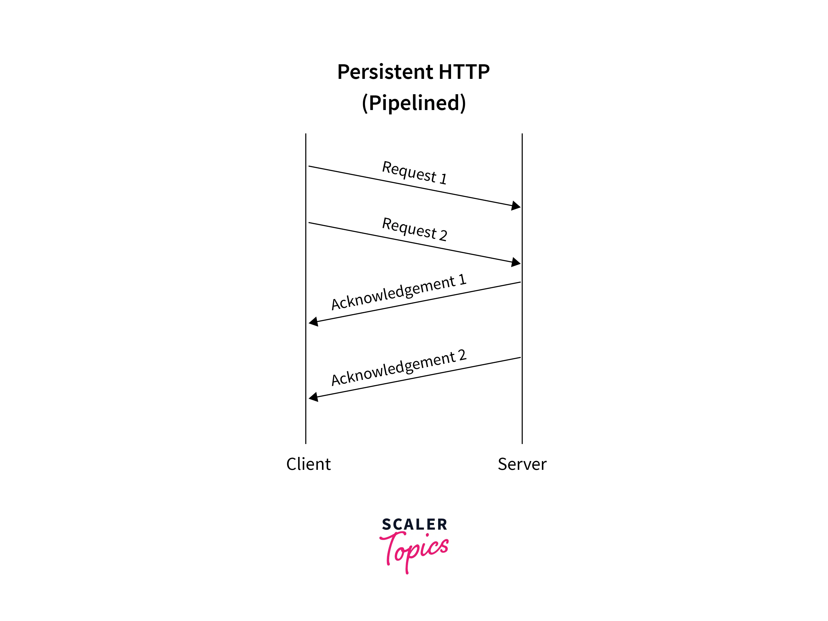
Internet Engineering

Slide 39
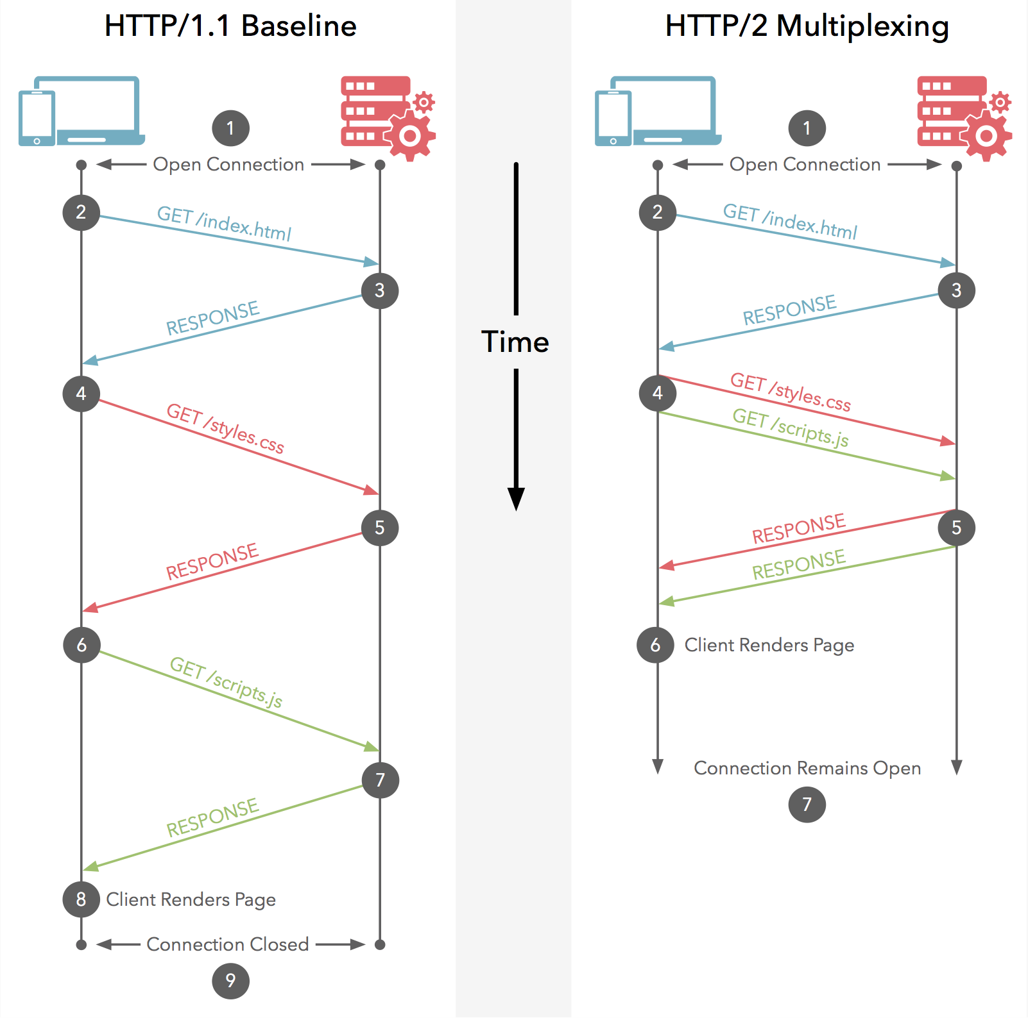
HTTP/2 for a Faster Web
HTTP Pipelining
HTTP Pipelining is not difficult to deploy, it is impossible.
it still allowed a single large or slow response to block all others that followed.
HTTP/2 Multiplexing
Multiplexing allows multiple request-response messages to be in flight over a single HTTP/2 connection, at the same time.
Internet Engineering

Slide 40
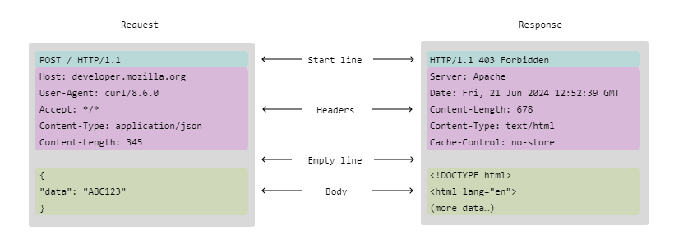
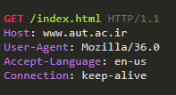
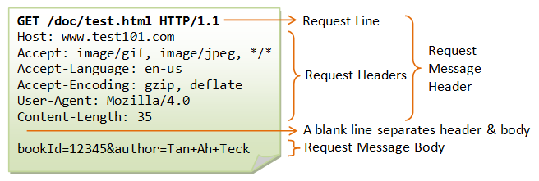
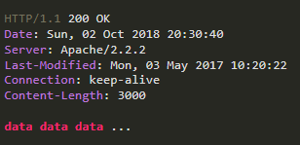
HTTP Messages
HTTP is text-based protocol
Human readable headers
The header is composed of some lines
Internet Engineering

Slide 41

HTTP Methods
Methods are actions that client asks from server to do on the specified resource (given by the path parameter)
Which actions?
Basic data communication operations
Safe operations
Get a resource from server
Send data to server
Unsafe operations
Delete a resource on server
Create/Replace a resource on server
Debugging and troubleshooting
Get information about a resource
Check what the server has got from a client
Get the list of operations which can be applied on a resource
Internet Engineering

Slide 42
HTTP Methods
GET: Retrieve resource from server
HEAD: Similar to GET but the resource itself is not retrieved, just the HTTP response header
Useful for debugging or some other applications
POST: Submit data to be processed by the specified resource
Data itself is enveloped in message body
DELETE: Remove the resource
Not popular in web, can be used in other applications
PUT: Add message body as the specified resource to server
PATCH: A PATCH request is considered a set of instructions on how to modify a resource.
Contrast this with PUT; which is a complete representation of a resource.
TRACE: Server echoes back the received message
For troubleshooting & debugging
OPTIONS: Request the list of supported methods by server on the resource
Internet Engineering

Slide 43
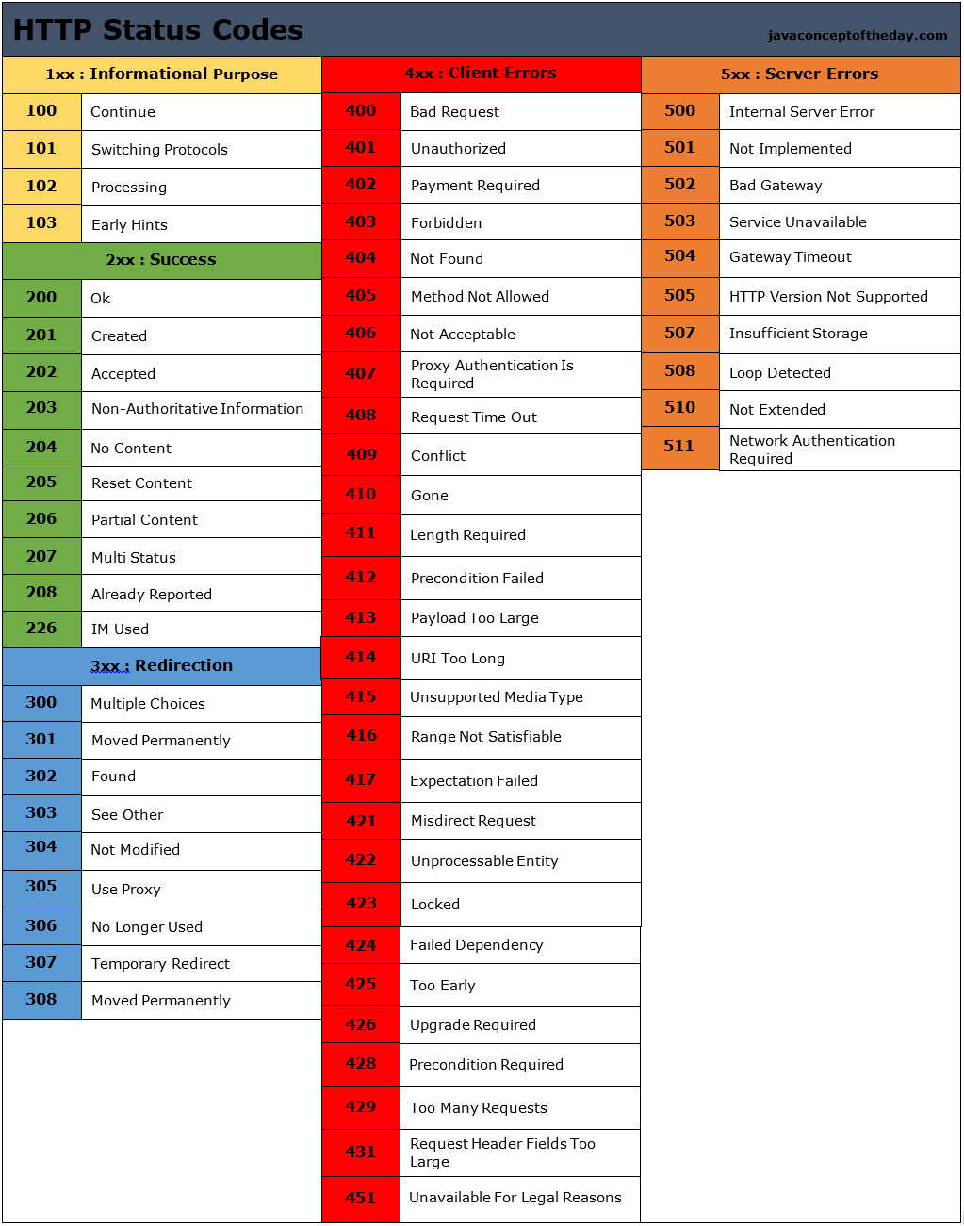
HTTP Response
The message for the result/response of the requested action
Which responses?
Basic responses
Success
Failure
Bad client request
Server problem
Others
E.g., Redirection to other resources
Internet Engineering

Slide 44

HTTP Headers
Headers are additional information that is sent by client to server and vice versa
Most (almost all) are optional
Which headers?
Information about client
Information about server
Information about the requested resource
Information about the response
Security/Authentication
...
General headers
Appear both on request & response messages
Request headers
Information about request
Response headers
Information about response
Entity headers
Information about body (size, ...)
Extension headers
New headers (not standard)
Internet Engineering

Slide 45

General Headers
Date: Date & Time that message is created
Connection: Close or Keep-Alive
Close: Non-persistent connection
Keep-Alive: Persistent connection
Via: Information about the intermediate nodes between two sides
Proxy servers
Internet Engineering

Slide 46

Request Headers
Host: The name of the server (required, why?)
Referer: URL that contains requested URL
Information about the client
User-Agent: The client program
Accept: The acceptable media types
Accept-Encoding: The acceptable encoding
Accept-Language: The acceptable language
Range: Specific range (in byte) of resource
Authorization: Response to the authenticate
Cookie: To return back the cookies
If-Modified-Since: Request is processed if the objected is modified since the specified time.
Used in Web Caching
Internet Engineering

Slide 47

Response Headers
Server: Information about server
WWW-Authenticate: Used to specify authentication parameters by server
Proxy-Authenticate: Used to specify authentication parameters by proxy
Set-Cookie: To send a cookie to client
Location: The location of entity to redirect client
Last-Modified: The date and time of last modification of entity
Content-Range: Range of this entity in the entire resource
Expires: The date and time at which the entity will expire
Internet Engineering

Slide 48
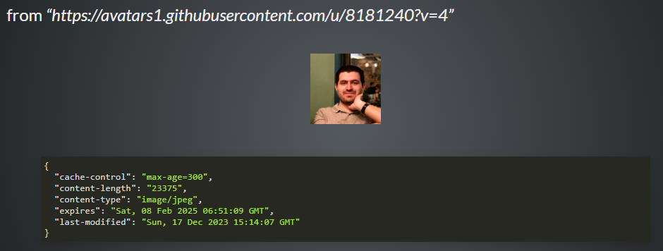
Entity Headers
Content-Length: The length of body (in byte)
Content-Type: The type of entity
MIME types: text/xml, image/gif
Allow: The allowed request methods can be performed on the entity
This is in response of OPTIONS method
Internet Engineering

Slide 49
Extension Headers
Custom proprietary headers have historically been used with an X- prefix, but this convention was deprecated in June 2012
implementation-specific and private-use parameters could at least incorporate the organization's name
ExampleInc-foo
VND.ExampleInc.foo (vnd stands for vendor)
or primary domain name
com.example.foo
http://example.com/foo
Internet Engineering

Slide 50
Tools
cURL
Postman
Hoppscotch
HTTPie
Internet Engineering

Slide 51
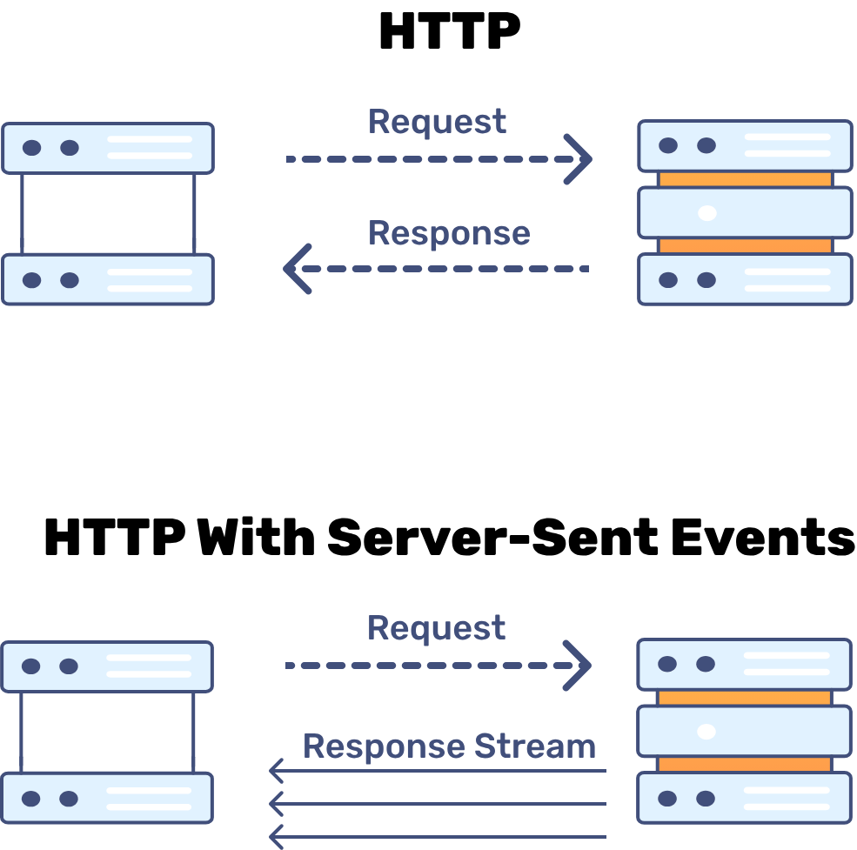
Server-sent events (SSE)
Traditionally, a web page has to send a request to the server to receive new data; that is, the page requests data from the server
With server-sent events, it's possible for a server to send new data to a web page at any time, by pushing messages to the web page.
Server-Sent Events (SSE):
server push technology enabling a client to receive automatic updates from a server via an HTTP connection, and describes how servers can initiate data transmission towards clients once an initial client connection has been established.
They are commonly used to:
send message updates
continuous data streams
EventSource, a client requests a particular URL in order to receive an event stream.
The EventSource API is standardized as part of HTML5 by the WHATWG. The media type for SSE is text/event-stream.
Internet Engineering

Slide 52
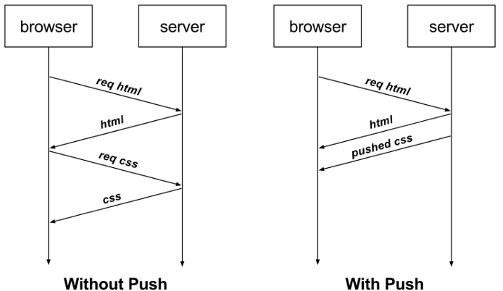

HTTP/2 Server Push
HTTP/2 Server Push is an optional feature of the HTTP/2 and HTTP/3 network protocols which allows servers to send resources to a client before the client requests them.
Server Push is a performance technique aimed at reducing latency by loading resources preemptively, even before the client knows they will be needed.
Internet Engineering

Slide 53

Cookie
Internet Engineering

Slide 54

Stateless Problem
HTTP is a stateless protocol
Server does not remember it's client
How to personalize pages (personal portal)?
Use http header: X-Forwarded-For
Is not usually sent by browsers
Find client IP address from TCP connection
The problem is NAT
Clients move but IP address does not
Solution of Stateless Problem: Cookie [RFC 6265]
Cookie: are information (e.g. unique identifiers) sent by server to user (browser) which are returned back to server
How it works:
Server asks client to remember the information
Set-Cookie header in response message
Set-Cookie: <cookie-name>= <cookie-value>
Client gives back the information to server in every request
Cookie header in request messages
Cookie: <cookie-name>= <cookie-value>; <cookie-name>= <cookie-value>
Server customizes responses according to the cookie
name=example_cookie; value=12345; domain=example.com; path=/; expires=Sat, 01 Jan 2025 00:00:00 GMT; Secure; HttpOnly
Internet Engineering

Slide 55

General Headers
Limitation
Cannot be used to store large data
At least 300 cookies
At least 4096 bytes per cookie
At least 20 cookies per unique host or domain name
Cookies are text files
No virus spread
There is not any request from server to read cookies
By default cookies are sent by browser
Browser checks URL and finds appropriate cookies
Client can control cookies
Disable cookies: no cookie is saved & used
View & Delete cookies
Server can control cookies by its attributes
Expiration time
Domain
Path
Security
...
https://httpbin.org
Internet Engineering

Slide 56


Cookies Attributes
Internet Engineering

Slide 57



Cookies Attributes: Domain & Path
Internet Engineering

Slide 58

CSRF
Internet Engineering

Slide 59


Internet Engineering

Slide 60


Cookies : برای ذخیره‌سازی داده‌های کوچک که نیاز به ارسال به سرور دارند (مانند توکن‌های احراز هویت).
Session Storage : برای ذخیره‌سازی داده‌های موقت که فقط در طول یک session خاص نیاز هستند.
Local Storage : برای ذخیره‌سازی داده‌های بزرگ‌تر و غیرحساس که نیاز به ذخیره‌سازی طولانی‌مدت دارند.
Internet Engineering

Slide 61

Proxy
Internet Engineering

Slide 62


Proxy
Proxies sit between client and server
Act as server for client
Act as client for server
Internet Engineering

Slide 63
Forward Proxies: Outbound
A forward proxy, or gateway, or just "proxy" provides proxy services to a client or a group of clients.
Reverse Proxies: Inbound
As the name implies, a reverse proxy does the opposite of what a forward proxy does:
A forward proxy acts in behalf of clients (or requesting hosts), a reverse proxy acts in behalf of servers.
Forward proxies can hide the identities of clients whereas reverse proxies can hide the identities of servers.
Reverse proxies have several use cases, a few are:
Load balancing: distribute the load to several web servers,
Cache static content: offload the web servers by caching static content like pictures,
Compression: compress and optimize content to speed up load time.
Internet Engineering

Slide 64


Internet Engineering

Slide 65
HTTP Proxy Applications
Authentication
Client side: Authenticate clients before they access web
Server side: Authenticate clients before access the server
Accounting: Log client activities
Security: Analyze request before sending it to server
Integrated in modern firewalls
Filtering: Limit access to specified contents
Anonymizer: Anonymous web browsing
Caching (more details in the following slide)
Internet Engineering

Slide 66

Caching
Caching: save a copy of a resource and use it instead of requesting server
Browser has its own local caches
Cache server is special proxy for caching
Benefits
Reduce redundant data transfer
Reduce network bottleneck
Reduce load on server
Reduce delay
Internet Engineering

Slide 67



Caching Algorithm
If the object is not cached, it is got from server, saved in cache, and sent to client
Else, if object is in cache
Cache server must return only fresh objects
Freshness check
Objects life-time specified by server
The Cache-Control HTTP/1.1 general-header field is used to specify directives for caching mechanisms in both requests and responses.
Expiration
No caching
Cache but revalidate
Internet Engineering

Slide 68


Caching Algorithm (Cont.)
Internet Engineering

Slide 69

Internet Engineering

Slide 70

Authentication
Internet Engineering

Slide 71

Authentication vs Authorization
Authentication is the verification of the credentials of the connection attempt.
This process consists of sending the credentials from the remote access client to the remote access server in an either plaintext or encrypted form by using an authentication protocol.
Authentication is the verification that the connection attempt is allowed.
Authorization occurs after successful authentication.
Internet Engineering

Slide 72


Authentication vs Authorization
Internet Engineering

Slide 73

Digest Authentication
Internet Engineering

Slide 74


Authentication vs Authorization
Internet Engineering

Slide 75

In real world…
There is no need for basic/digest authentication in our new world we can send plaintext passwords over secure HTTP.
In both ways, we need a solution for stateful connection to not repeat the authentication procedure for every request.
Internet Engineering

Slide 76

Bearer Authentication
Bearer authentication (also called token authentication) is an HTTP authentication scheme that involves security tokens called bearer tokens
The name Bearer authentication can be understood as give access to the bearer of this token.
JWT
JSON Web Tokens are an open, industry standard RFC 7519 method for representing claims securely between two parties.
Internet Engineering

Slide 77

Authentication vs Authorization
Internet Engineering

Slide 78

Security
Digest authentication protect password only
Data is completely insecure
No mechanism in HTTP to protect data
HTTP over SSL/TLS is the popular solution
An encrypted tunnel between client & server
Send HTTP traffic through the tunnel
Internet Engineering

